Slide 1
Transcribing Melodies
Audio Processing and Indexing Final Project, 10 December 2024
Qianpu Chen
Gaurisankar Jayadas
Amber van den Broek
Robin P.M. Kras

Slide 2
Introduction
Importance
AI has revolutionized music analysis and learning.
Objective
To develop a system to accurately transcribe guitar melodies into tablature using audio processing techniques.
Accurate transcription systems can help musicians learn solos, producers analyze compositions, and researchers study music theory.

Slide 3
Problem Statement
Isolating the guitar from other instruments.
Accurately detecting notes in complex recordings.
Mapping detected notes to guitar strings and frets.
Select an audio file that includes (rock) guitar.
Produce coherent tablature.

Slide 4




Preliminaries: Tools and Libraries
Used tools include:
Librosa for audio processing.
Numpy for numerical operations.
Matplotlib for visualizations.
Jupyter Notebook for implementation and demo.

Slide 5
System Overview: Pipeline
Preprocessing: Load and normalize the audio.
Source separation: Isolate the harmonic (melodic) component using HPSS.
Feature extraction: Detect pitches using pitch tracking.
Transcription: Map pitches to guitar strings and frets.
Output generation: Format results into readable tablature.
Each step can be debugged or replaced independently.
A pipeline allows for future enhancements (or replacing components) without reworking the entire system.

Slide 6
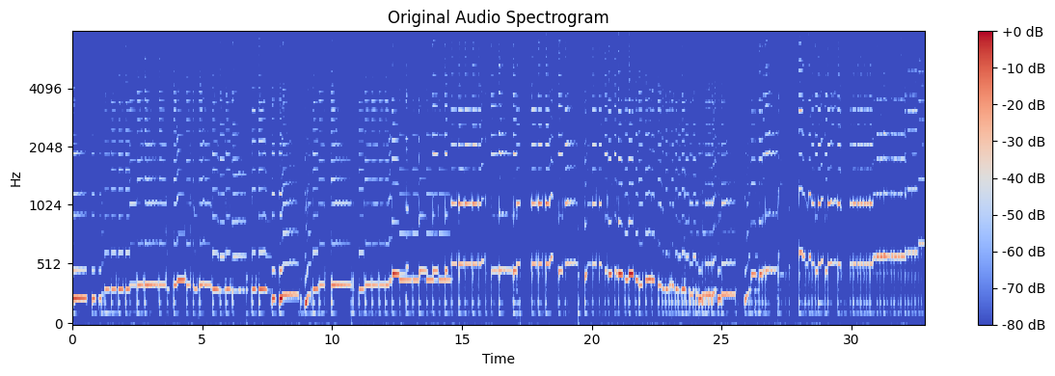
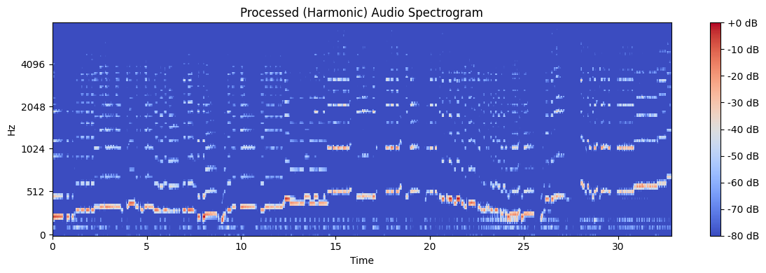
System Overview: Preprocessing and Source Separation
Audio Preprocessing:
Load audio at 22050 Hz and normalize it.
Show a waveform or spectrogram of raw audio.
Source Separation:
Separate harmonic and percussive elements.
Before
After

Slide 7
System Overview: Feature Extraction
By using librosa.piptrack() for pitch detection, we can extract pitches with the highest magnitude in each time frame.
+Piptrack is lightweight and effective for monophonic signals (like a guitar single melody).
This enables filtering low-energy pitches to reduce noise.
+This prevents noise from being interpreted as valid notes.

Slide 8
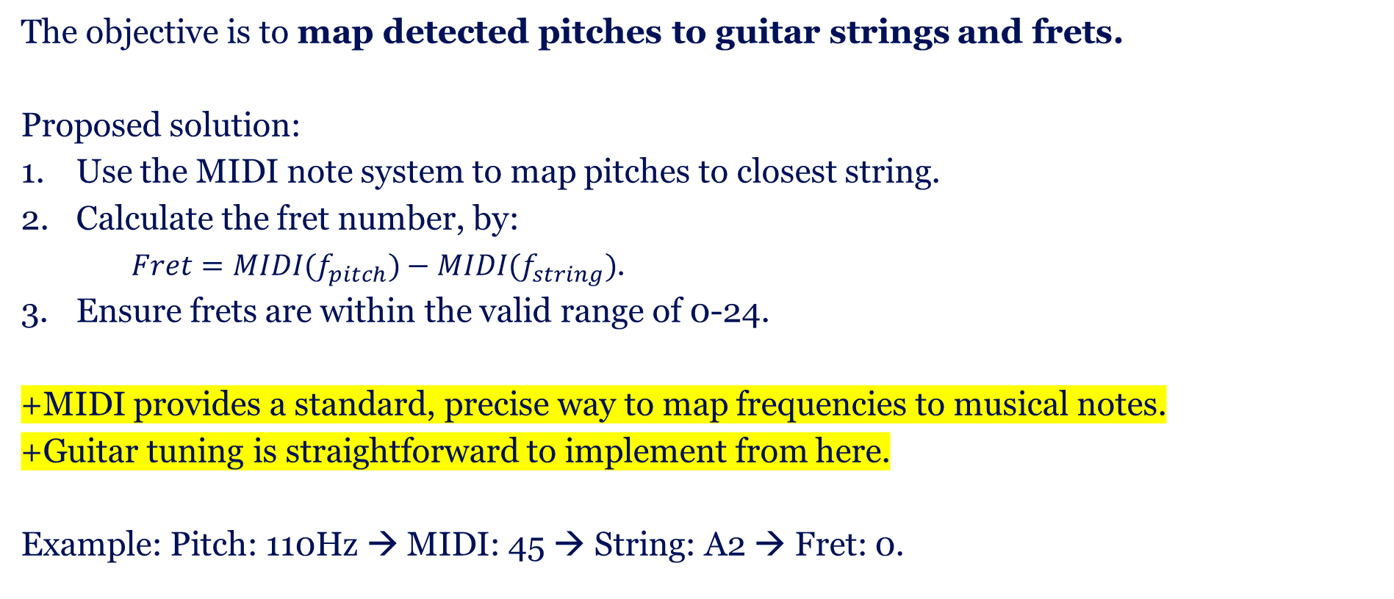
System Overview: Transcription
The objective is to map detected pitches to guitar strings and frets.
Proposed solution:
Use the MIDI note system to map pitches to closest string.
Calculate the fret number, by:
$Fret=MIDI(f_{pitch})−MIDI(f_{string})$.
Ensure frets are within the valid range of 0-24.
+MIDI provides a standard, precise way to map frequencies to musical notes.
+Guitar tuning is straightforward to implement from here.
Example: Pitch: 110Hz → MIDI: 45 → String: A2 → Fret: 0.

Slide 9
System Overview: Output
The objective is to format detected notes into readable guitar tabs.
Steps:
Represent each string as a sequence of frets.
Dashes (-) denote silence or unused strings.
+Tabs are widely used by guitarists, thus making the output intuitive.
+The format is simple to implement programmatically.
E2 | 0 | 3 | 5 | -
A2 | - | 2 | 3 | 5
D3 | - | - | 5 | 7

Slide 10
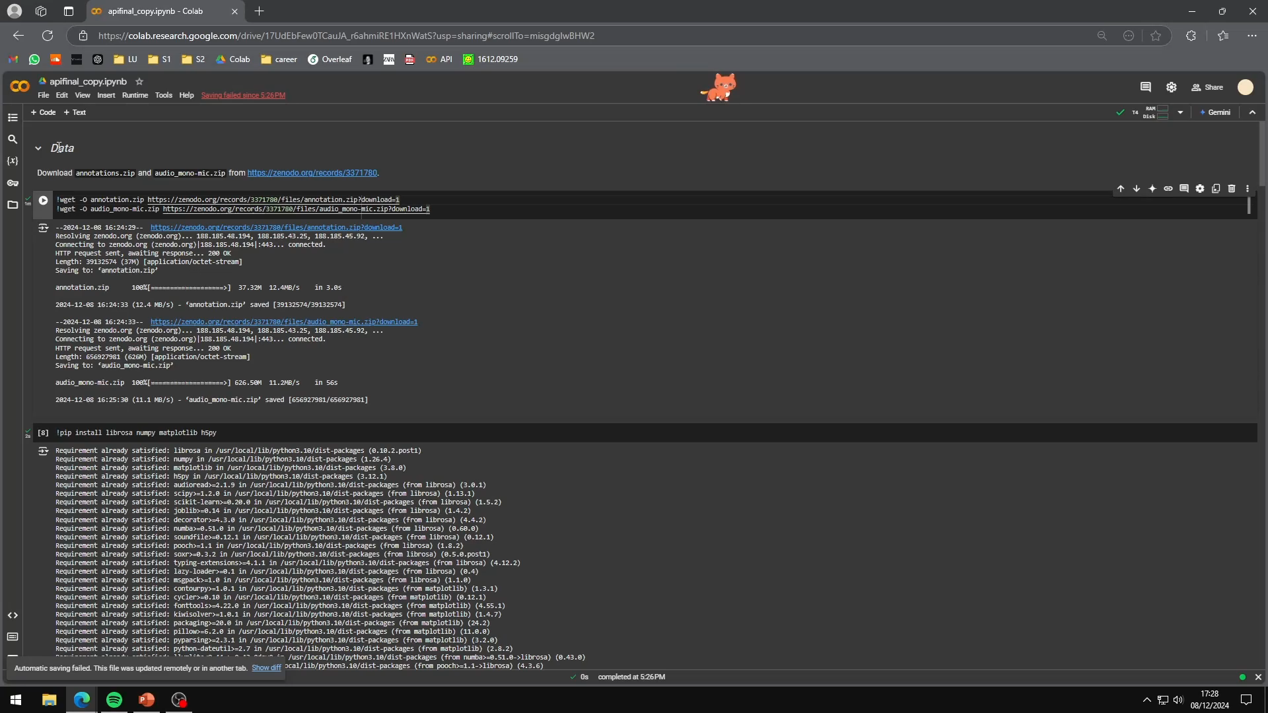
Demo

Slide 11

Questions

